Slide 1
Corporate Overview
OZ Optics Optik Ticaret A.S.
October 2023

Slide 2
Table of Contents
OZ Optics A.Ş. Company Profile
OZ Optics A.Ş. Core Competencies
OZ Optics A.Ş. Organization
OZ Optics Ltd.
OZ Optics Ltd. Products
OZ Optics Canada
OZ Optics China
OZ Optics Competitive Advantages

Slide 3
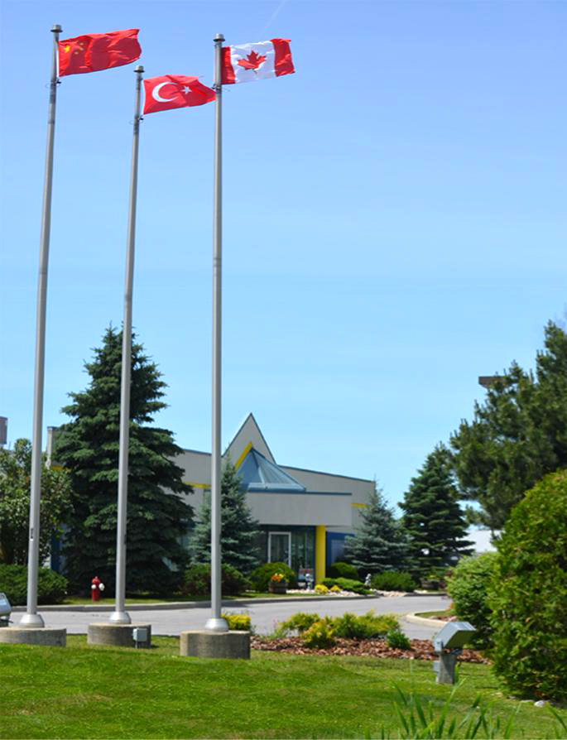
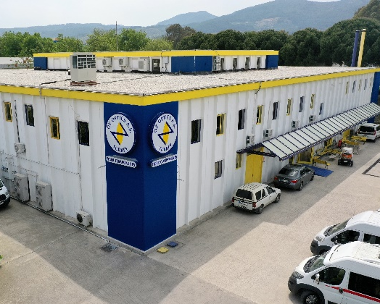
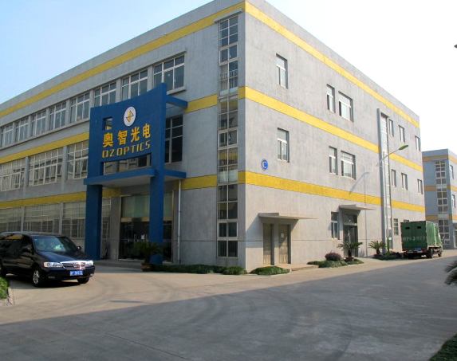
Company Background
Founded in 1985
Corporate headquarter located in Ottawa, Canada
Manufacturing facility in
Ottawa / Canada, Izmir / Turkey and Jiaxing / China
Ten Product Groups:
  Laser-to-Fiber Delivery Systems
  High Power Fiber Optic Components
  Polarization Maintaining Products
  Attenuators
  Opto-Electronic Packaging
  Fiber Optic Test Equipment
  Fiber Optic Sensor Systems
  Fiber Optics Components for Gyroscope
  OCT
  BioPhotonics
Sales offices in
Canada, USA, Europe, Turkey and China
Ottawa, Canada
Izmir, Turkey
Jiaxing, China

Slide 4
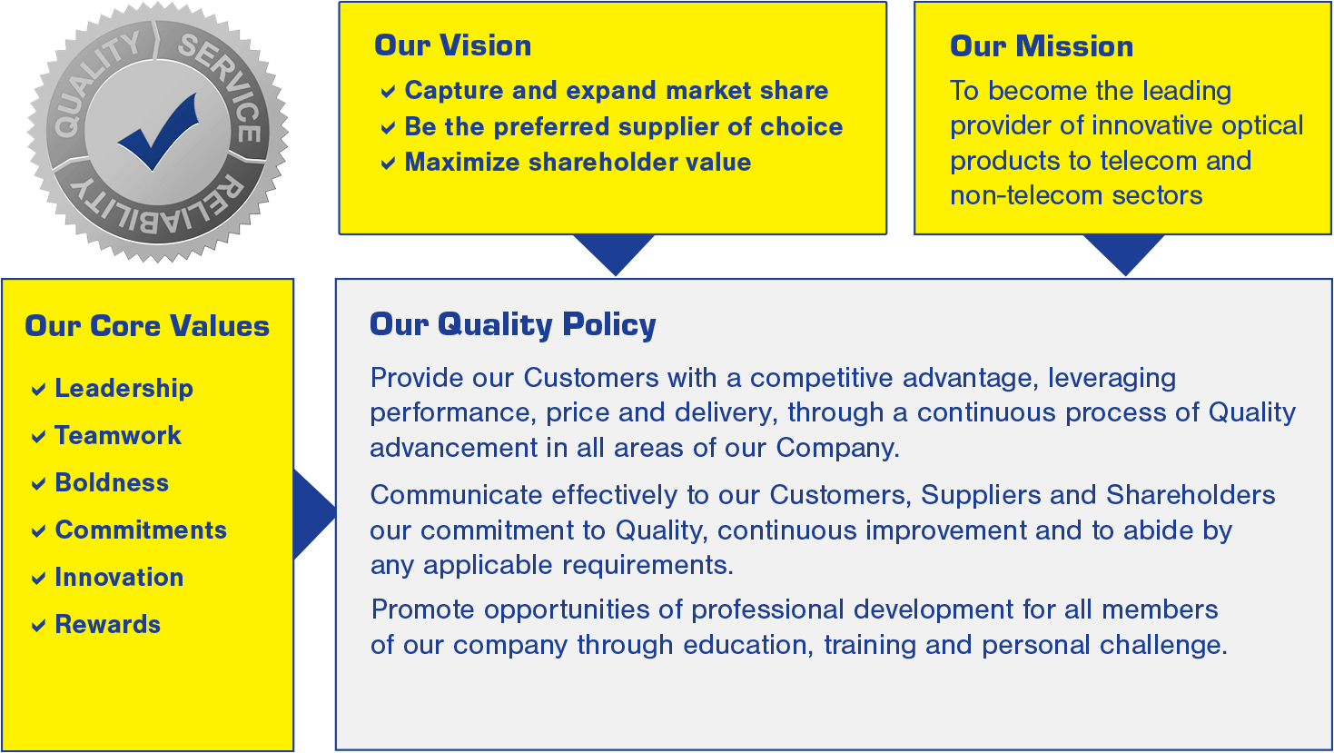
Corporate Statements and Quality Policy

Slide 5
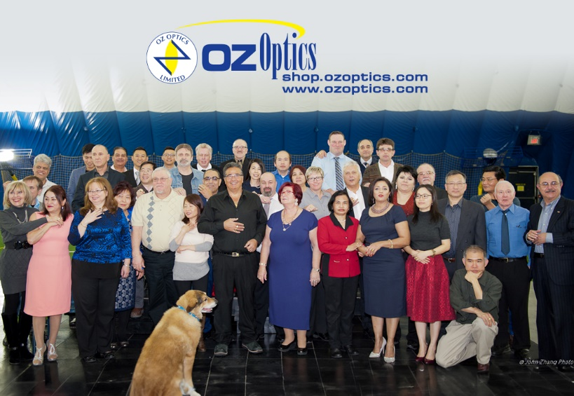
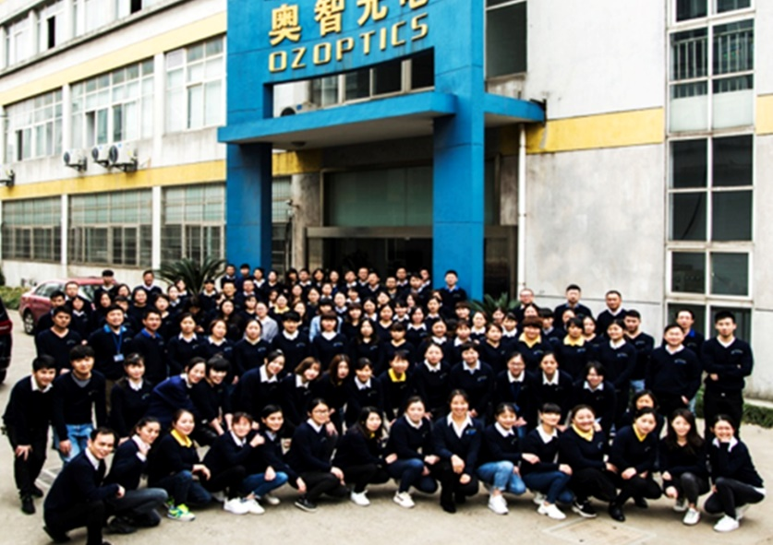
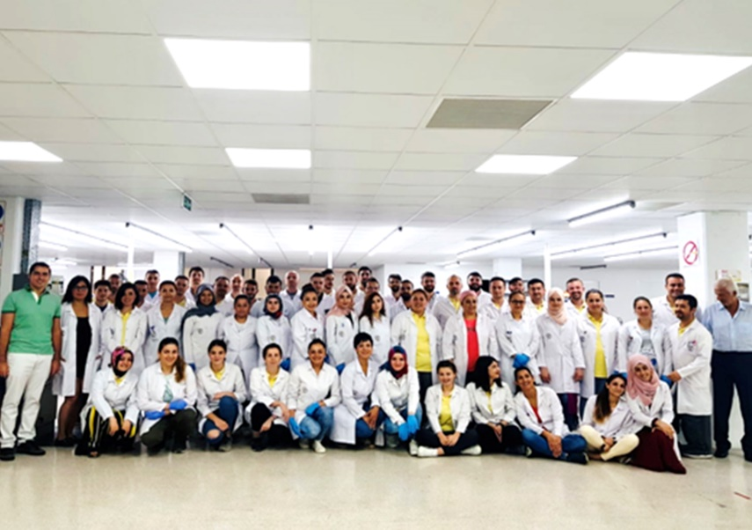
Company Profile
Over 525 employees worldwide
OZ Canada
OZ China
OZ Turkey
263+
Employees
97+
Employees
165+
Employees

Slide 6
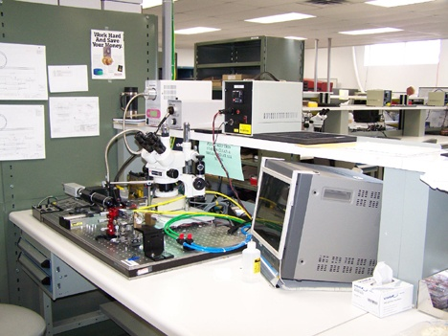
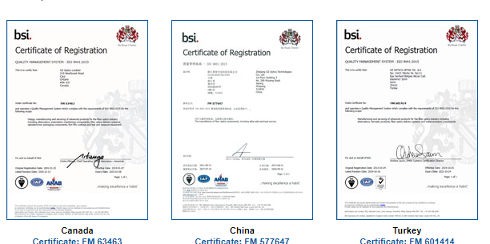
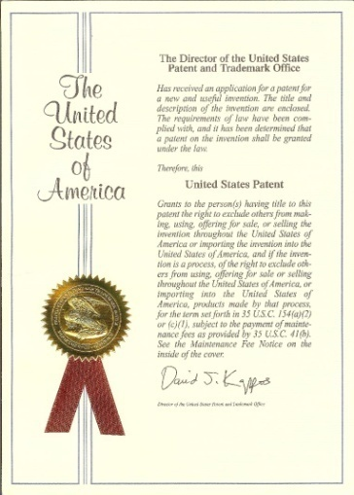
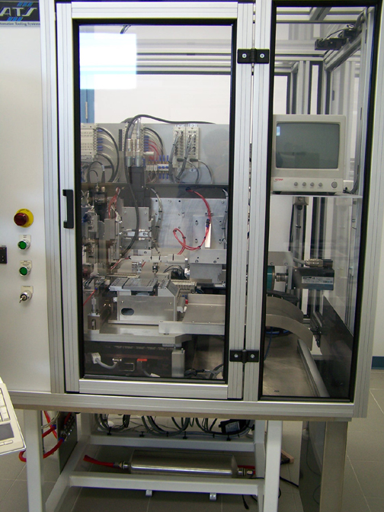
Company Profile
ISO9001:2015 Certified
Advanced Proprietary Processing Technology
Broad Patent Portfolio

Slide 7

Company Profile
OZ Optics is Lead by an Experienced Team:
Ömür Sezerman, Chairman, President & CEO
    Founder and CEO since inception (39 years)
Zahide Sezerman, VP of Human Resources
    With OZ Optics since inception (39 years)
Garland Best, VP of Components Division
    32 years at OZ Optics
Gordon Youle, VP of Test Equipment Division
    25 years at OZ Optics
Onur Koca, General Manager of OZ Turkey
    2 year at OZ Optics
Bing Li, General Manager of OZ Optics China
    20 years at OZ Optics

Slide 8
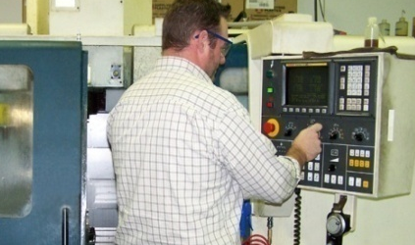
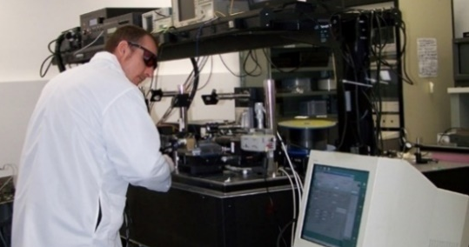
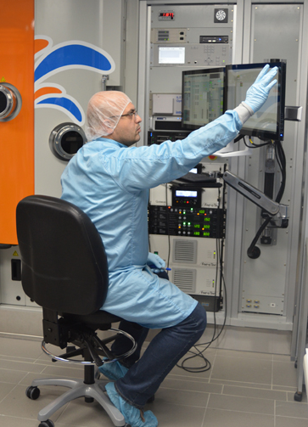
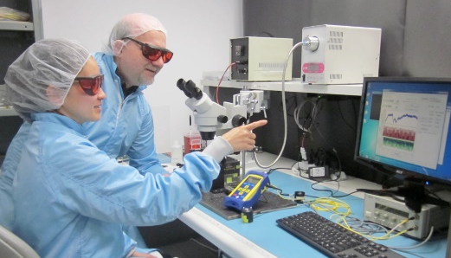
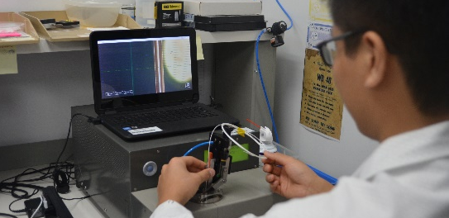
Company Profile
Experienced and Well-Trained Staff in Following Fields:
Optical, Mechanical, Electronics & Software
CNC Machine Shop
Femto-Second Laser Lab
AR Coating
Clean Room
Laser Conditioning/Cleaving

Slide 9
Core Competencies
Pioneer in Polarization Maintaining (PM) Components
Leader in Wavelength Flattened,
High Power & Low PDL Components
Leader in High Power Fiber Optic Delivery Systems
Custom Test Equipment, Including Polarization Test
Equipment and FTTH Equipment
Widest Range in Attenuator Product Offering
Fiber Optic Distributed Strain and Temperature Sensors
Complete product line for OCT, Gyroscope
& BioPhotonics applications & 2 Micron
Now available: Spectrometers and Quantum Light Sources

Slide 10
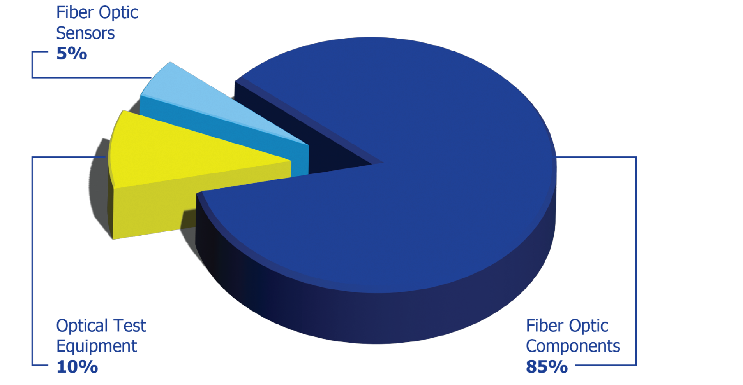
Leading Technology
Three Product Groups
Over 1,000 Products
Leading Edge R&D

Slide 11
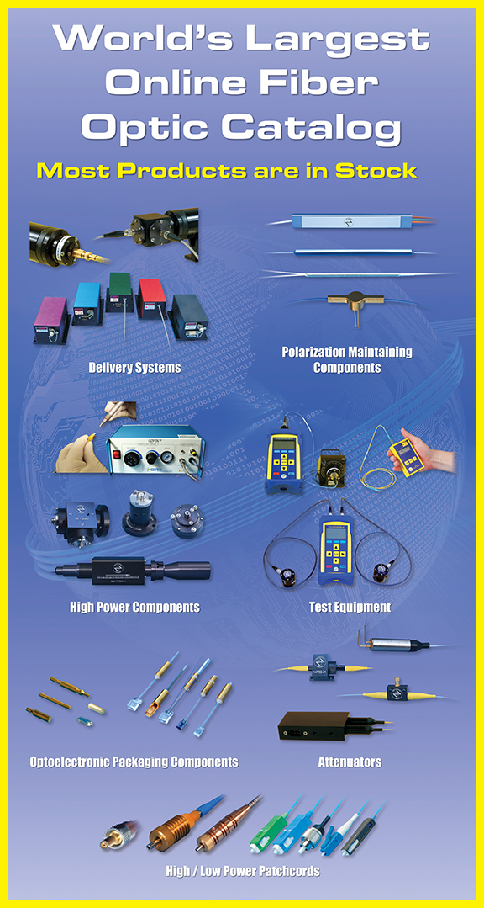
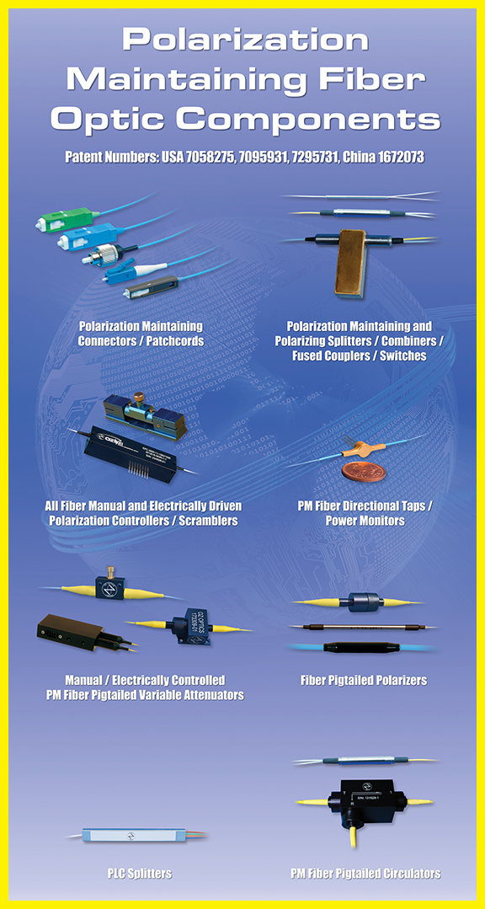
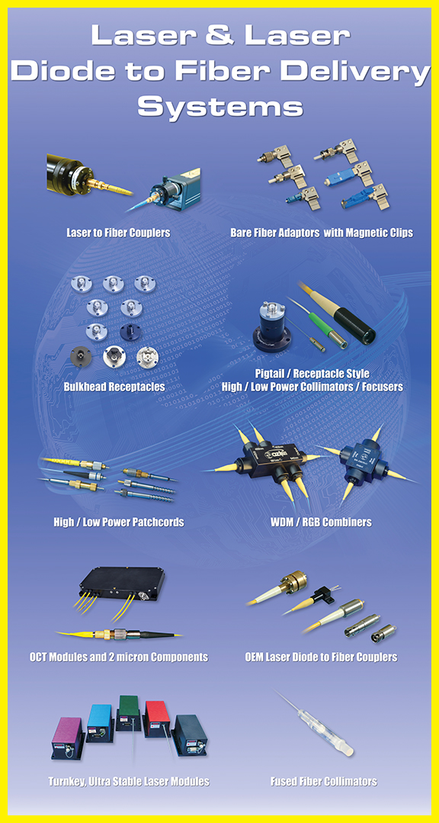
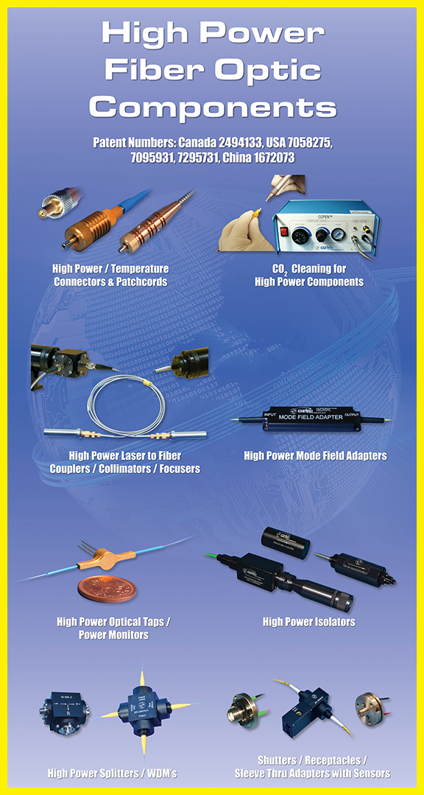
Leading Technology
Featured Products

Slide 12
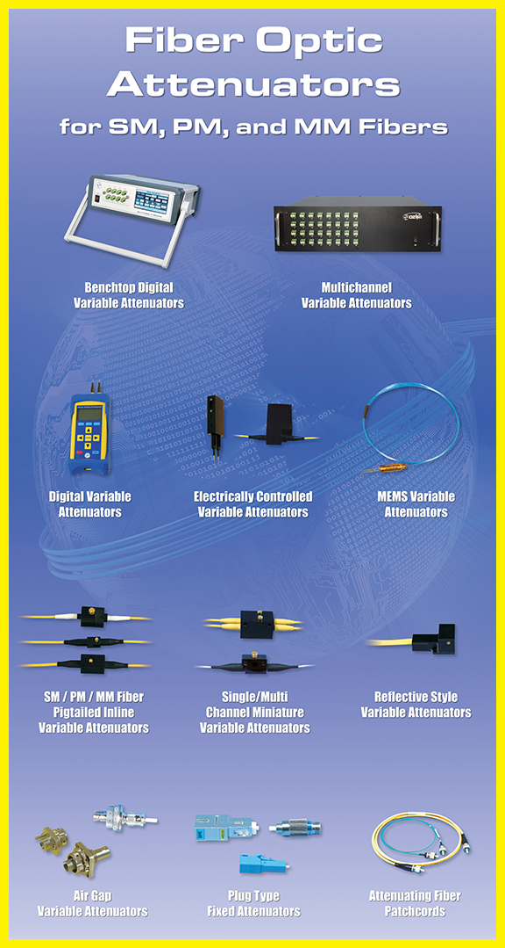
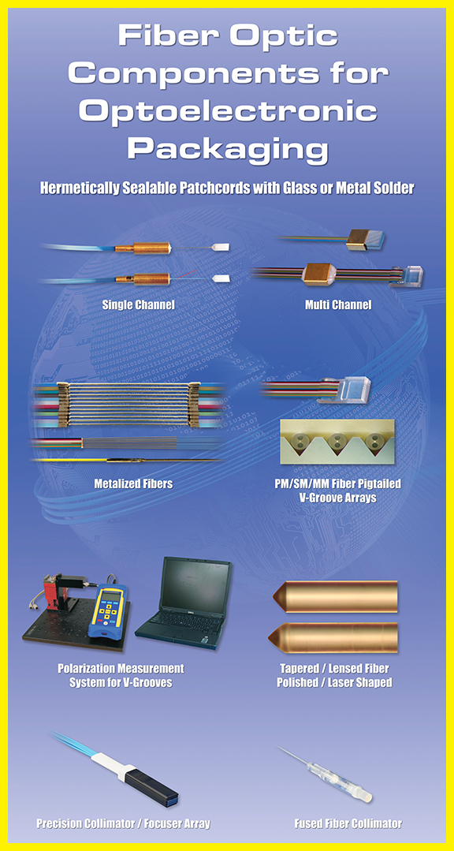
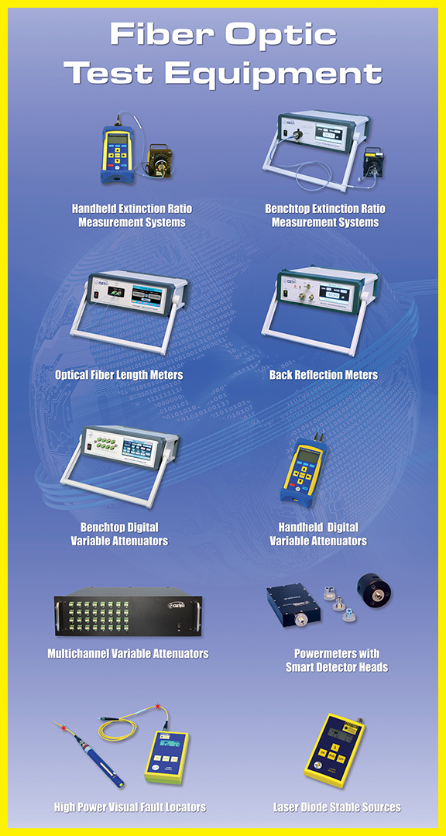
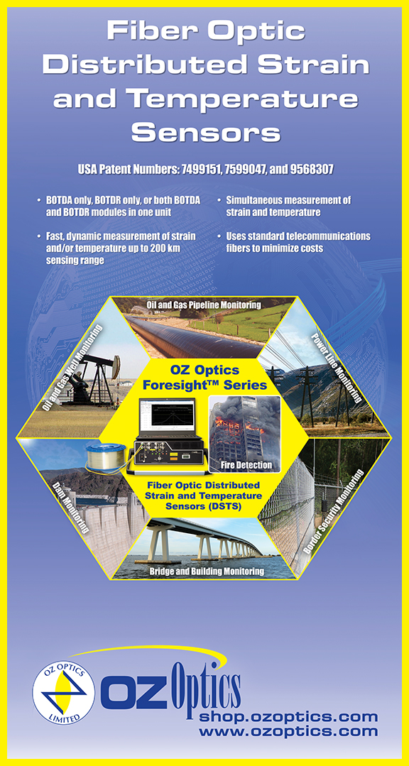
Leading Technology
Featured Products

Slide 13
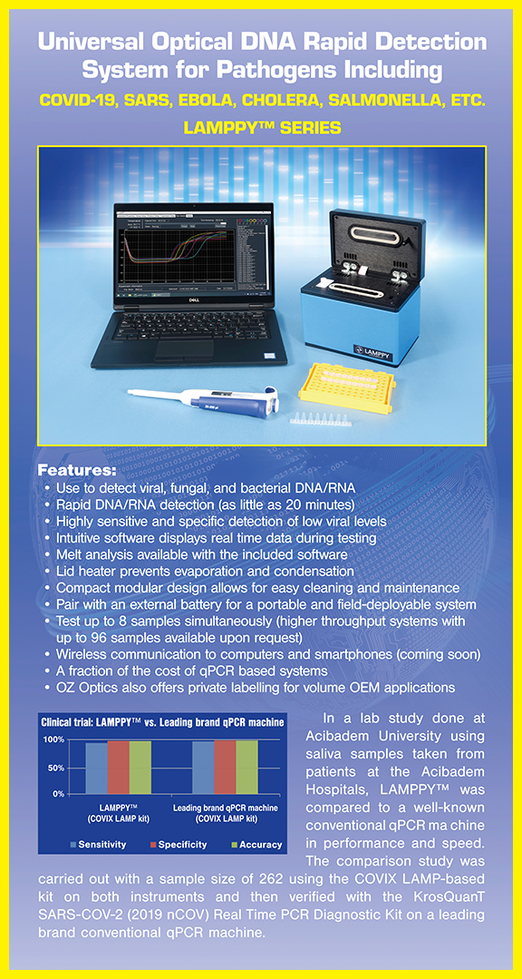
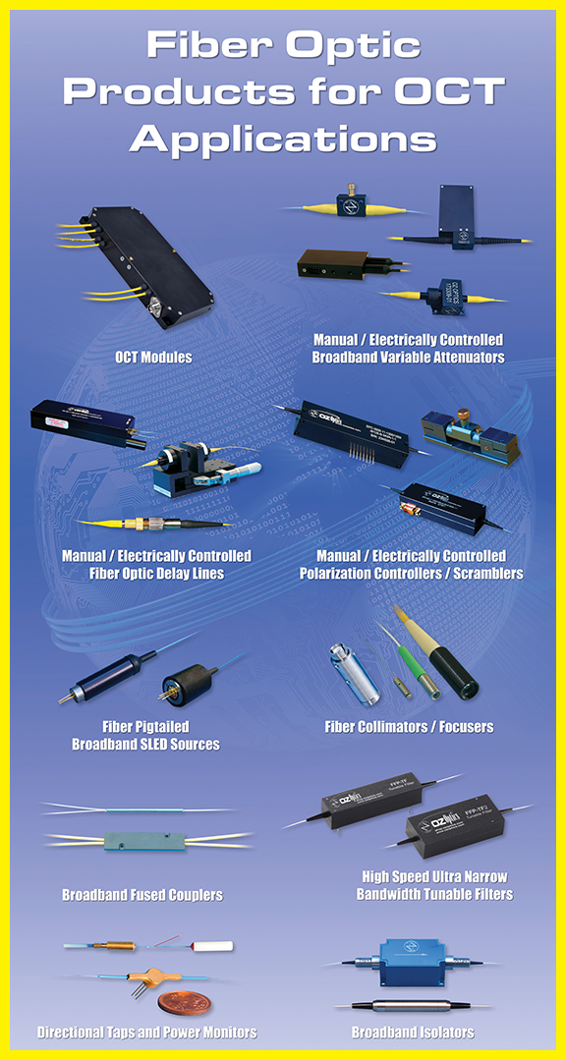
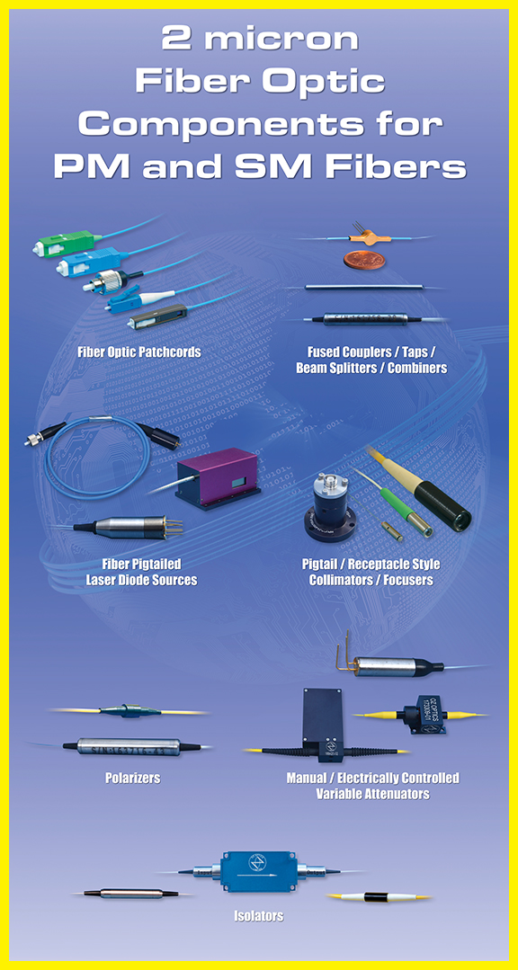
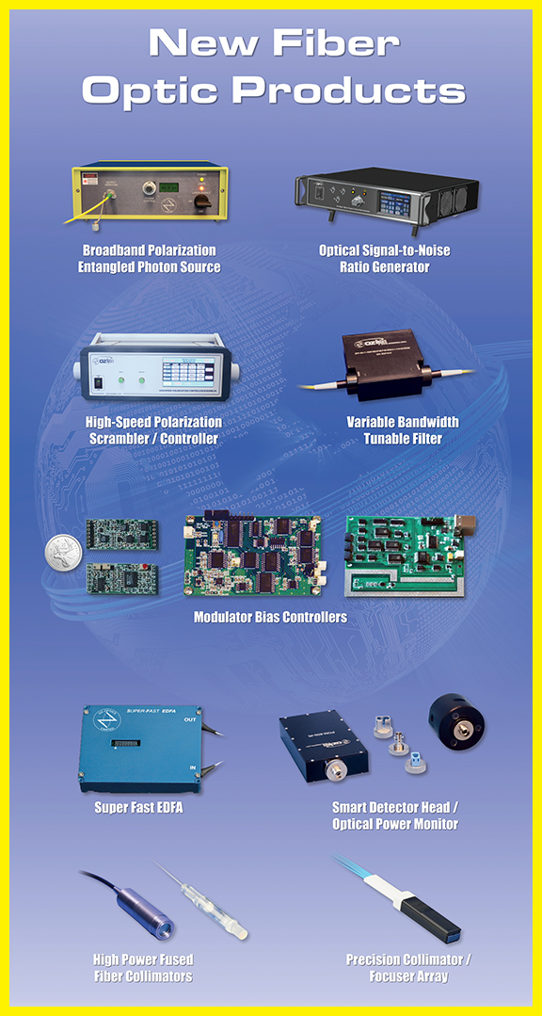
Leading Technology
Featured Products

Slide 14
Industry Standards
All Products Manufactured are in Strict Accordance
with International Industry Standards:
ISO 9001:2015 Certified (Canada, China and Turkey)
REACH Compliance
RoHS Compliance
CE Compliance
Telecordia Compliance
Controlled Goods Directorate Registered
Critical supplier for F35 and F18 Project
TSCA (Toxic Substance Control Act) Compliance
CHEMSHERPA Compliance
IEC 61010 Compliance

Slide 15

Marketing Strategy
Application Market
Using our strong direct sales and distributors, we address the following markets:
Energy – Oil and Gas
Military and Homeland Security
Educational
Industrial
Telecom / Datacom
Medical & Pharmaceutical

Slide 16
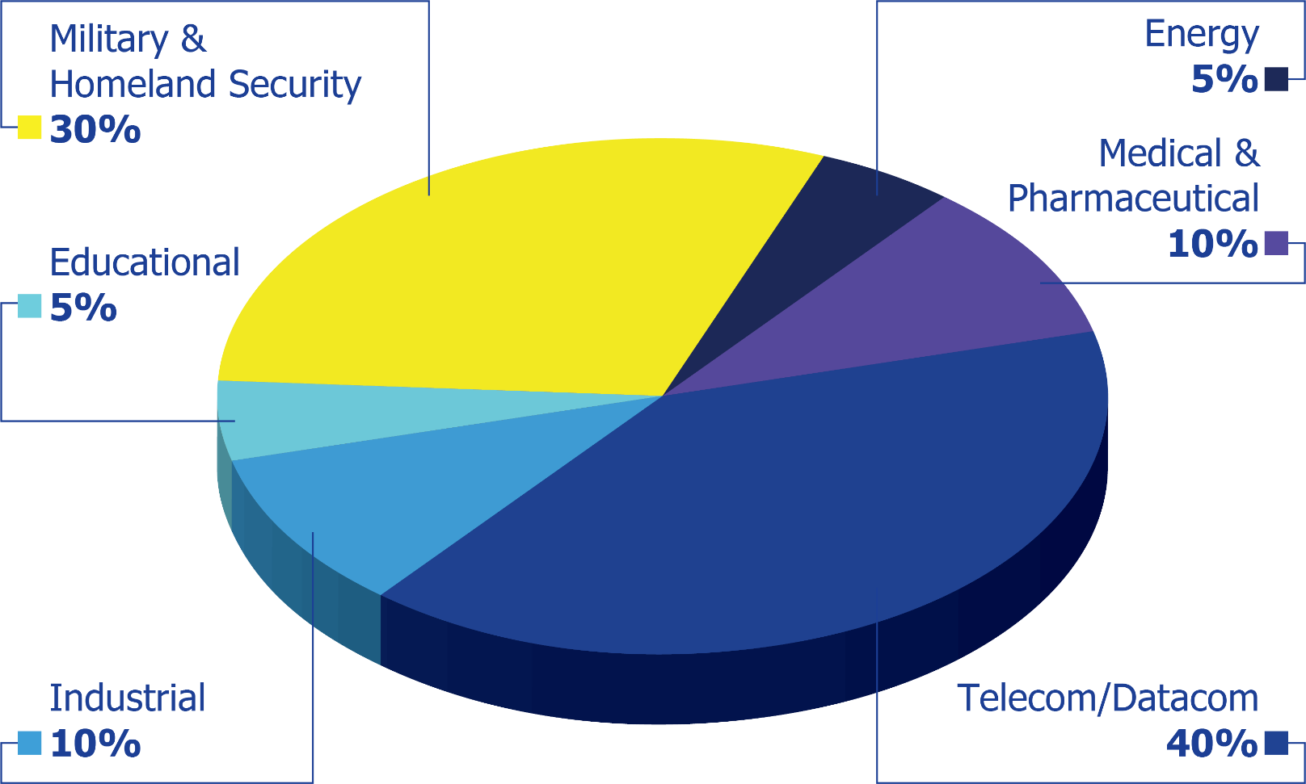
Marketing Strategy
Application Market
By leveraging the technology and expertise gained since its inception, OZ Optics has attracted a broad range of customers in the telecom / datacom, medical, military, security, industrial, construction, aerospace, power utilities, petrochemical and educational sectors.
Revenue Allocation:

Slide 17




























Marketing Strategy
Global Sales Network
OZ Optics has resellers and distributors in over 30 Countries and Regions with over 10,000 customers worldwide:
Austria
Belgium
Brazil
Canada
China
Denmark
France
Germany
Greece
Hong Kong
India
Ireland
Italy
Japan
Luxembourg
Netherlands
Norway
Poland
Portugal
Singapore
South Korea
Sweden
Switzerland
Taiwan
Thailand
Turkey
United Kingdom
United States

Slide 18


Operation Strategy
Manufacturing Strategy
OZ Optics Canada
R&D/Design/Engineering
OZ CND Qualification
Sub-Components
OZ CND Qualification
Customer
Sub-Components
Customer
Made in China
Made in
Turkey
Customer Qualification
Customer Qualification
Worldwide Sourcing
Customer
OZ Optics Canada
R&D/Design/Engineering

Slide 19






Marketing & Operation Strategy
Competitive Advantage
Superior Technology
Innovative Engineering
Competitive Pricing
Global Presence
Extensive Experience
in Fiber Optics Manufacturing
Exceptional Quality and Service
Exceptional Quality
And Service
Superior Technology
Innovative Engineering
Success
Extensive Experience
in Fiber Optics Manufacturing
Competitive
Pricing
Global
Presence

Slide 20
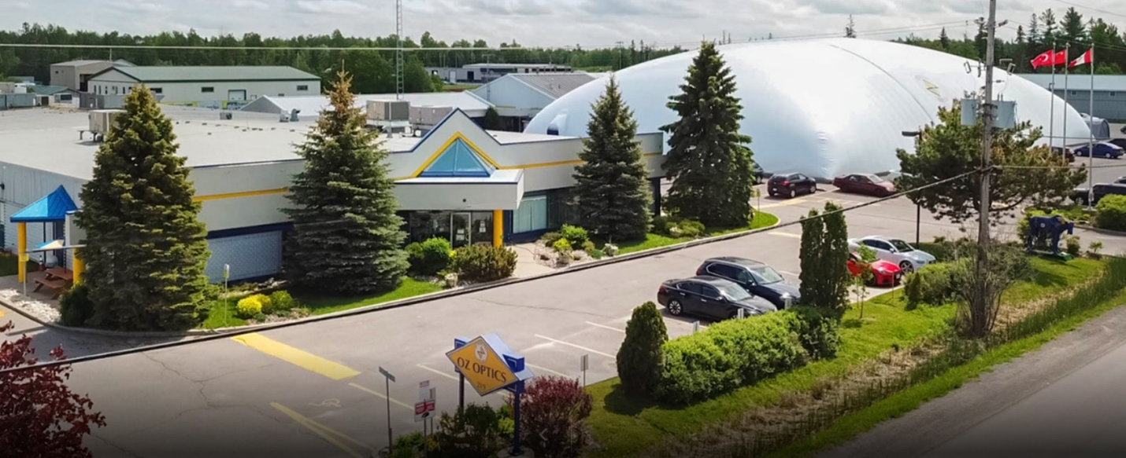

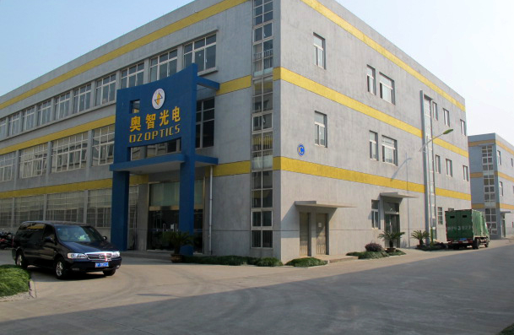
Branch Network
OZ OPTICS CANADA (Headquarters)
OZ OPTICS TURKEY (Turkey Factory)
OZ OPTICS CHINA (Jiaxing Factory)

Slide 21
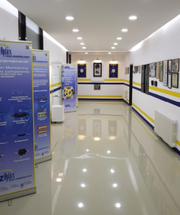
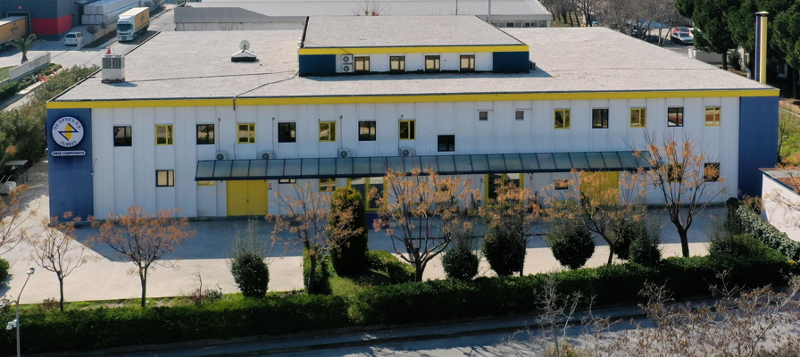
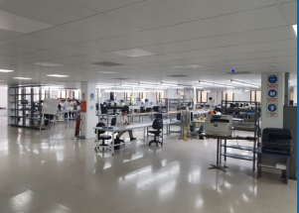
OZ Optics A.Ş. Company Profile
OZ Optics A.Ş. manufacturing facility founded in 2000 in
Aegean Free Zone Gaziemir, Izmir.
OZ Optics A.S. manufactures high-tech and high quality systems for export.
OZ Optics A.S. expanded its capacity and organization in Izmir with
building and machinery investments starting in 2021.
OZ Optics A.Ş. also plans to supply fiber systems for the Defense Industry
in Turkey, in addition to the export portfolio with capacity
increases from its 3,100 m² production facility.

Slide 22
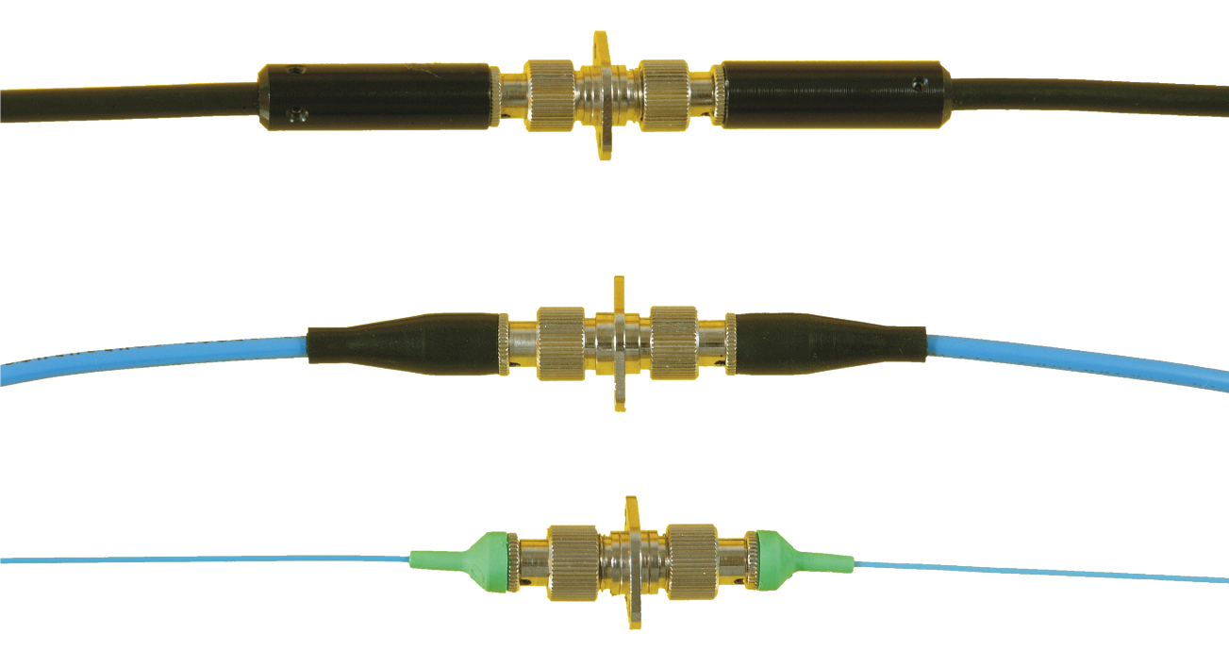
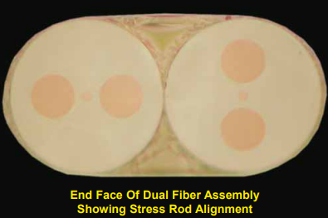
OZ Optics A.Ş. Core Competencies
Existing Production Lines:
Polarization Maintaining (PM) Components
Hermetic Assemblies
Fiber Optic Components
Laser-to-fiber delivery
High Power Components
V-Groove Assemblies
AR Coating
Collimators
Production Lines to be added in near future:
Laser Diode Packaging
Attenuators
OCT Applications
PM Fiber Patchcords with FC/PC Compatible
Connectors and Different Cable Sizes

Slide 23
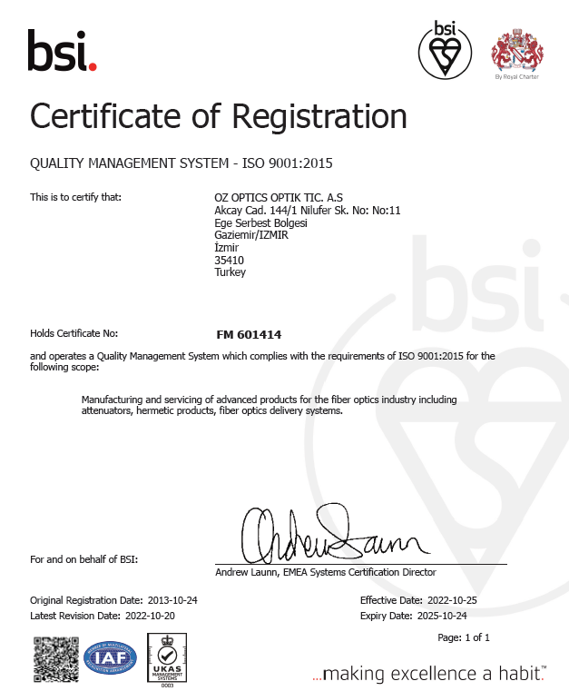
OZ Optics A.Ş. Industry Standard
OZ Optics A.S. manufactures assemblies according to ISO 9001:2015 Quality Management System requirements and Advanced Proprietary Processing Technology.

Slide 24
Thank You for
Choosing OZ Optics
Please Contact Our Sales Department:
Tel: +90 232 252 3531 ext. 6177
Email: sales@ozoptics.com.tr

